Slide 1
Diversity in the Workplace
INT 5900: Preparation for Experiential Learning

Slide 2
Learning Objectives
Learn about the diverse forms of identity and how they can be encountered in the workplace
Identify ways to achieve career goals through one’s identity
Review of Title IX policies and rights
Be able to respond professionally to potentially reportable workplace situations

Slide 3
Looking at Cultural Differences
HSBC

Slide 4

Characteristics of Cultural Diversity
Willingness to share, risk change, and explore
Understand the power of action and words
Open to each other’s differences
Having an attitude that “Different is okay or interesting”
Ability to recognize learning opportunities
Respectful to each other
Commitment – Co-Responsibility
Notes:
Open to differences does not mean acceptance. Respect and appreciation does not always equate to agreement but it may be a pathway to tolerance that allows us to see things from different perspectives.
Ignorance is a two way street as well as a co-responsibility of both parties. It is OK to be different but trying to understand that difference may go a long way to patient centered care.

Slide 5
Can we see differences just by looking at people’s outward appearance?
Why do we value diversity in the workplace?
What does diversity mean to you?
Notes:
When we discuss diversity in the US, we often look from a white lens, however, for our students who are people of color, it is often not representative of their experience. So through these three questions we are able to understand from their perspective what diversity means to them.

Slide 6

What is Your Brand?
What is unique about you that you want to share?
What sets you apart from the rest?
How will you make your mark in your field/discipline?

Slide 7


Tim Brown & Joey Zwillinger
Had a vision – shoe company that used a non-commercial approach
Specific passion – a product that is comfortable, fashionable and environmentally responsible
Found a way to incorporate this into their company and everyday work
Now worth more than $1 billion
Notes:
Feel free to change to another example. Podcast about allbirds on How I Built this - allbirds: Tom Brown & Joey Zwillnger

Slide 8
What’s Your Narrative?
Break
Break into groups of 5
Talk about
Talk about your first name and where it came from
Meaning behind it
Family legacy
Cultural heritage etc.
Share about
Share about your hometown and what makes it special to you
Notes:
Share about your own identity and then open to the class.
*We chose first name and not last name because in Indian culture, sometimes last names reveal their social status, and it can be a sensitive topic

Slide 9
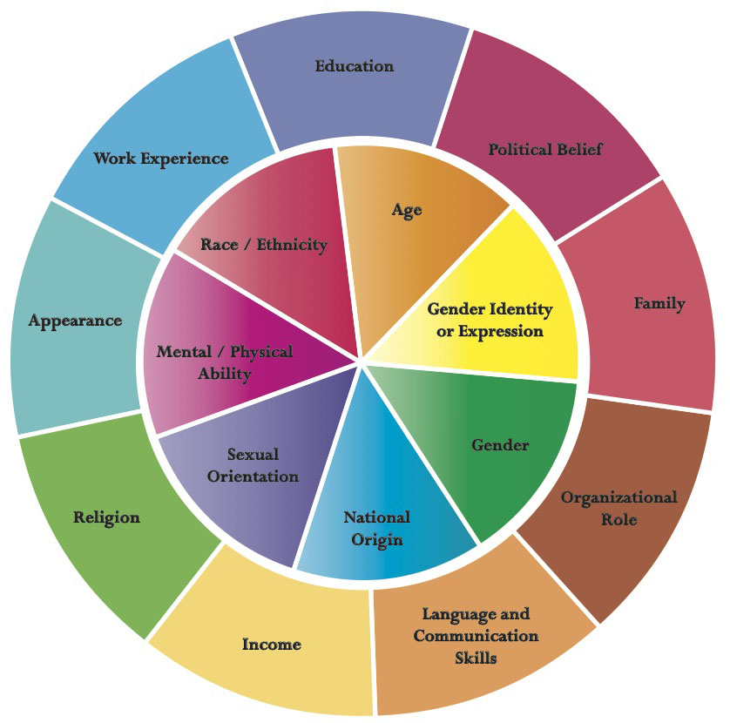
Dimensions of Diversity
Notes:
The inner circle of those things that we can perceive or are more easily informed of such as race, gender, ethnicity, sexual orientation, etc.
However, when we explore the dynamics of diversity within our organizational cultures we see dynamics that go beyond this “inner circle”. . .
When we look at these dimensions of diversity outside of the inner circle we see things that affect us each and everyday but that we may not necessarily acknowledge as diversity dynamics. In the case of cultural competency (as we will define later) these dimensions in combination with those on the inner circle present a variety of dynamics that affect individual and organizational performance. Historically, diversity as it has been framed at times within the paradigms of compliance (EEO/Affirmative Action) can be limiting in the evolution into cultural competency, we can look at various dimensions as part of a continuum
THINK about the dimensions of diversity within your organization.
RECALL examples of how these dimensions have created better solutions and how challenges or problems have arisen as a result of the dynamics within each dimension.
DESCRIBE the example and the outcomes in the space below or with your colleagues after completing this module.

Slide 10
The US Workplace
There are currently 4 generations in the workplace; soon to be 5
Disabilities affect 20% of all Americans
Women earn 57% of Bachelor degrees awarded in the United States in 2018
4.5% of individuals in the U.S. identify as LGBTQ
87% - 94% of individuals who are harassed in the workplace do not file a complaint
Notes:
https://www.shrm.org/hr-today/news/hr-news/conference-today/pages/2017/5-generations-7-values-endless-opportunities.aspx
https://www.csac.ca.gov/sites/main/files/file-attachments/cenbr975.pdf
https://www.pewresearch.org/fact-tank/2019/06/20/u-s-women-near-milestone-in-the-college-educated-labor-force/
https://www.nbcnews.com/feature/nbc-out/record-4-5-percent-u-s-adults-identify-lgbt-gallup-n877486
https://www.eeoc.gov//eeoc/task_force/harassment/upload/report.pdf

Slide 11
Diversity Efforts
Depending on the company you work for, you might:
Attend diversity training.
Part of Orientation
Required training of all employees and contractors
Can involve harassment/discrimination training and other subjects
Have to complete diversity forms prior to joining.
Ask your advisor for help if you are not familiar

Slide 12

Gender Identity
Gender identity is the personal sense of one's own gender. Gender identity can correlate with assigned sex at birth or can differ from it. All societies have a set of gender categories that can serve as the basis of the formation of a person's social identity in relation to other members of society.
Notes:
Stress that it is not men vs. women!
Gender identity is different from sexual orientation.

Slide 13
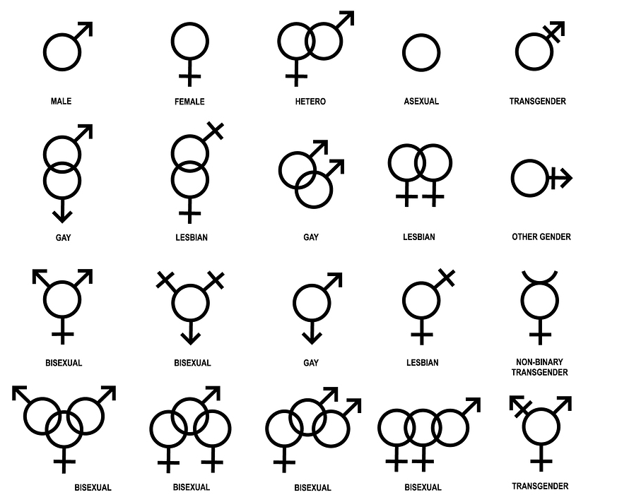
Notes:
It’s not about knowing everything in depth or speak to it, but to not assume someone’s identity based on how they look or their name.

Slide 14
Gender Identity
Pronouns
If it’s not specified, do not assume the person’s preferred pronoun
Be aware when writing emails, cover letters or other communication messages!
When in doubt, use their name or if name is not provided, a general title such as “hiring manager.”
Avoid sir, m’am, mr., ms., mrs. etc. if unsure!
Can also use gender neutral honorifics such as “Dr. Lastname, Director Lastname”
Notes:
Google the person and see how they refer to themselves in their online bio

Slide 15


Notes:
Companies have dedicated to celebrating the Pride month or displaying the Pride flag at various spaces or in various capacities. More offices and workspaces are moving to gender neutral bathrooms so anyone can use any bathroom space available.
Share Melissa’s student story about Pride flag

Slide 16

Microaggression
The everyday verbal, nonverbal, and environmental slight, snubs, or insults, whether intentional or unintentional, that communicate hostile, derogatory, or negative messages to target persons based solely upon their marginalized group membership.
Notes:
Remind students that microaggression doesn’t have to be racial. It can also be discrimination against one’s gender, orientation, mental or physical disability, nationality, identity and experience etc.
Good video that uses film to illustrate different types of microagression: https://www.youtube.com/watch?v=bjzWENcW6NQ

Slide 17
Scenario 1
Jane is a veteran employee at Sunshine Technologies Inc. She is managing a new intern, Sally who is currently pursuing her graduate degree. Sally has full time work experience previously in this field. Jane is assigning Sally a new project, and states the following:
“I’m sure you have never seen or worked with this before, so let me show you how to do it.”
Is this a microaggression? What are the different ways Sally can respond?

Slide 18
Scenario 2
Bob is attending a workshop at Raincloud Technologies Inc. with co-workers. Bob presents visually non-white. During lunch break, he gets in line with his fellow white co-workers to grab food, and proceeds to put dressing on his salad. After his salad is already dressed, a woman behind the counter rushes over to explain what each of the dressing options are, but does not do this with his co-workers.
Is this a microaggression? What are the different ways Bob can respond?

Slide 19
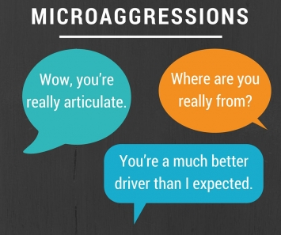
Microaggressions
Notes:
Instructor can share own experience or experience of others and ask students to provide any they might have.

Slide 20
Microaggression
Debrief
Debrief with your family, friends, co-workers
Bring
Bring it up with your supervisor, co-op coordinator or HR
Document
Document any incidents

Slide 21
How to Respond
Pause
Do not feel the need to educate on the spot!
Do not need to react right away
Have a Conversation
If you feel comfortable, you can approach the aggressor and share how their words impacted you or another
Remember to approach it with a growth mindset and to think of how it will change future interactions (situation dependent)

Slide 22
Title IX Policy
Northeastern has an obligation for freedom from harassment and discrimination for all
Extends to searching for a co-op and while you are on co-op as well as when you are a student on campus

Slide 23
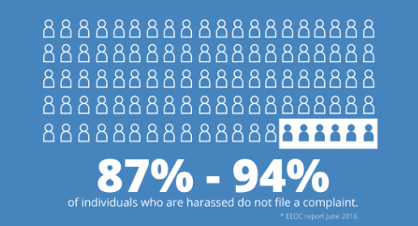
Gender-based Harassment
Notes:
https://www.eeoc.gov//eeoc/task_force/harassment/upload/report.pdf

Slide 24
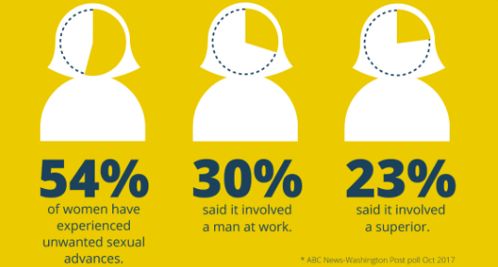
Gender-based Harassment

Slide 25
Your Rights
You have the right to work and learn in an environment that is not hostile and does not make you uncomfortable
If you do report, you have the right for your identity to remain anonymous, and for the accused to not know your name
If you experience retaliation after a report, you should have the right to report that with immediate action

Slide 26
Who to Talk to
To be kept confidential:
Office of Prevention and Education (OPEN)
Website: www.northeastern.edu/open
Email: open@northeastern.edu
Phone: 617-373-4459
Report any incidents to your onsite supervisor or HR personnel (may not be kept confidential depending on situation or company policy)
Report to your co-op coordinator if you feel comfortable; this information would be private, but non-confidential
Notes:
Co-op coordinators are mandated reporters. We have to report any incidents of Title IX violations, so we cannot promise confidentiality.

Slide 27
Scenario 1
Kelly has been at her co-op for two months. About a month ago, Kelly’s supervisor began coming to her workspace to see how she was progressing on her project. During these visits, the supervisor would always put his arm on her shoulder and lean in close to her face to review her work on the computer. Kelly has found herself leaving the room whenever her supervisor enters in attempts to avoid further interactions.
Do you think this is a form of harassment? What should Kelly do next?
Notes:
Whenever someone alters their behavior or routine in order to feel comfortable or safe, it is an indicator of harassment.

Slide 28
Scenario 2
Jim has really enjoyed working with his intern team. However, he has noticed that Chad has been more flirtatious in conversations and tried to throw out the idea of going on a date. Recently, Chad has been chosen to select team members to join him on a special project. Chad approaches Jim and shares that if Jim agrees to a date this Saturday, he will select Jim to be a member on the special project.
Do you think this is a form of harassment? What should Jim do next?

Slide 29
Questions?

